Slide 1
Write Your Own Functions II
Feitian College Summer Data Camp
July 14, 2019

Slide 2

Final Python class for summer camp!

Slide 3
Agenda for today’s class
Anonymous Functions
Built-in Functions
Use of Anonymous Function with Built-in functions
Return Statement
Recursive Functions
How Recursion works?
Recursion Tree
Recursive v/s Iterative Functions
Scope of Variable
Global v/s Local Variables
Power Of Python
Application of Python
Programming Examples

Slide 4
Anonymous / Lambda Function
Anonymous functions are called anonymous because they are not declared in a standard manner using the def keyword.
Instead, a lambda keyword is used to create small anonymous functions.
This is basically a function without any name.
Syntax:
lambda [argument]: [expression]

Slide 5
Anonymous / Lambda Function II
Some properties of anonymous functions:
The lambda form can take any number of arguments but returns just one value in the form of an expression.
They cannot contain commands or multiple expressions.
An anonymous function cannot include a direct call to print because lambda requires an expression.
Lambda functions have their own local namespace and can not access variables other than those in the parameters list and global namespace.
Note: Lambda functions are syntactically restricted to a single expression.

Slide 6
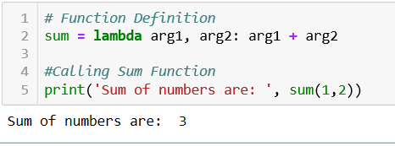
Example of Lambda Function
Program to add two numbers
Line 2 defines the lambda function.
Lambda function is followed by two arguments arg1 and arg2 and then a colon (:) followed by expression (sum of both numbers.)
This lambda function is then allocated the name sum.
The lambda function is called the same way other functions are, in line 5.

Slide 7
Built-In Functions
The Python interpreter has a number of functions that are always available for use. These functions are called built-in functions.
For example, the print() function prints the given object to the standard output device (screen) or to a text file.
In Python 3.6 (latest version), there are 68 built-in functions. Some of the most commonly used functions are shown next.

Slide 8
Some Examples of Built-In Functions
Methods | Description | Example (Input → Output)
Python abs() | Returns absolute value of a number | abs(-20) → 20
Python bin() | Converts integer to binary string | Bin(8) → '0b1000'
Python bool() | Converts a value to Boolean | bool(0) → False
Python chr() | Returns a character (a string) from an integer | chr(4) → '\x04'
Python dict() | Creates a Dictionary | dict(x=5, y=2) → {'x': 5, 'y': 2}
Python hex() | Converts integer to hexadecimal | hex(10) → '0xa'
Python input() | Read and returns a line of string | x = input('Enter x')
Python int() | Returns integer from a number or string | int('8') → 8

Slide 9
Methods | Description | Example (Input → Output)
Python len() | Returns length of an object | len([1,2,3,4,5,6]) → 6
Python max() | Returns largest number | max([1,2,3,4,5,6]) → 6
Python min() | Returns minimum number | min([1,2,3,4,5,6]) → 1
Python pow() | Returns x to the power of y | pow(2,3) → 8
Python print() | Prints the given object | Print(‘Hello’) → Hello
Python list() | Creates list in Python | list((1,2,3,4)) → [1, 2, 3, 4]
Python range() | Returns sequence of integers between start and stop | list(range(1, 7)) → [1, 2, 3, 4, 5, 6]
Python round() | Rounds a floating point number to ndigits places | round(1.6) → 2
Python set() | Returns a Python set | set([1,2,2,3,3,4,4,5]) → {1, 2, 3, 4, 5}
Python sorted() | Returns sorted list from given iterable | sorted([5,2,8,12,56,1,0]) → [0, 1, 2, 5, 8, 12, 56]
Python sum() | Add items in the iterable | sum(1,2) → 3

Slide 10
Using Anonymous Functions with Built-In Functions
Anonymous Function (called lambda function) can be used with various Built-in functions with the following patterns:
lambda() with filter()
lambda() with map()
lambda() with reduce()

Slide 11
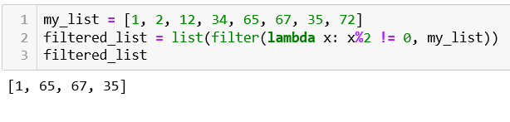
1) lambda() with filter()
The filter() function is an elegant way to filter out elements in a sequence for which the function returns True.
The filter() function takes in a function and list of arguments.
The lambda function tales argument x and filters odd numbers (by checking if x % 2 != 0).
The filter method takes this lambda function as one argument and a list named my_list as the other.
This method will filter the my_list sequence using the lambda function.
list() then converts the filter object into list of numbers.
Program to filter odd numbers from list of numbers

Slide 12
2) lambda() with map()
The map() function returns a list of results after applying the given function to each item of the iterable (list, tuple, etc).
The map() function in Python takes in a function and list of argument.
This function is called with a lambda function and a list. A new list is returned which contains the modified items returned by the lambda function for each item.
The returned value from the map function is a map object which can then be converted to a list or set.
Syntax:
map(function, iterable)
Parameters:
Function: It is a function to which map passes each element of the given iterable.
iterable: It is an iterable which is to be mapped.
Note: You can pass one or more iterables to map() function.

Slide 13
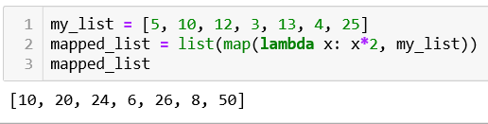
E.g.: multiply each element of list by 2
The map() function here takes two arguments. One is a lambda function; the other is a list.
The map() function takes every element in the list named my_list and applies the lambda function on it which then multiplies the number by 2.
The returned value from map() function is a map object. It can then be passed to list() to convert it to list.

Slide 14
3) lambda() with reduce()
The reduce (function, sequence) function is used to apply a particular function to all the elements in the sequence.
This function performs a repetitive operation over the pairs of the list.
How it works:
In the first step, first two elements of the list are picked and result is obtained.
Then next element and the previous result are picked. This is repeated until no element is left in the list.
No examples for reduce() today

Slide 15
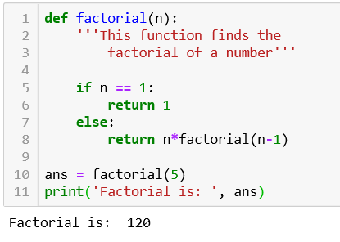
Recursive Functions
Recursion is a way of programming or coding in which a function calls itself one or more number of times in its body.
Program to find factorial of a number
In the function, if the value of n is 1 then it will return 1 as shown in line 5 and 6.
Else if it is not 1 then it will multiply that number with factorial of one less than that number as shown in line 8.
In line 8, we can see that the function is calling itself with one less value.

Slide 16
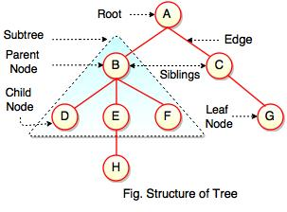
How Recursion works?
A recursive function calls itself until the base condition is True.
While false it will keep placing execution context on top of the stack.
The working of recursion can be visualized with the help of a recursion Tree.
What is a recursion Tree?
- Recursive tree diagrams the recursive calls and the amount of work done in each call.
- Recursion Tree can be useful for gaining intuition about the closed form of a recurrence, but they are not the proof.
What are Trees?
Collection of nodes connected by directed (or undirected) edges.
Non linear data structure as compared to arrays, stacks or queues.

Slide 17
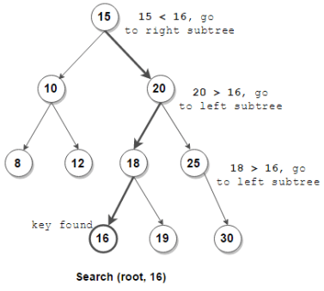
Binary Search Tree
Binary Search Tree is a great example of:
(a) Recursion
(b) Tree data structure
(c) Using those two together
In this example, skip linear iteration, use tree iteration for faster searches.
O(log N) vs O(N)

Slide 18
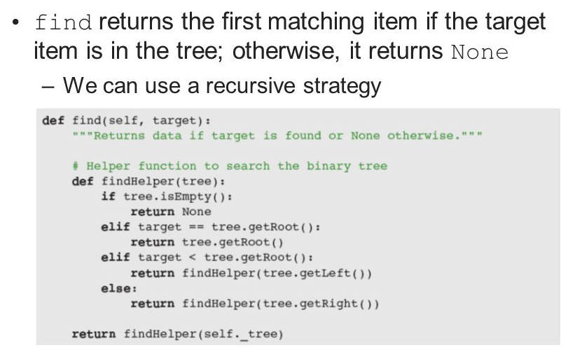
Binary Search Tree in Python
Recursive function find()
Recursive functions usually have a helper, in this case findHelper()
Notice base cases (empty, root) and recursive calls (left, right)
Code sample from “Fundamentals of Python” https://slideplayer.com/slide/5261359/

Slide 19
Recursive v/s Iterative Functions
Property | Recursive Functions | Iterative Functions
Definition | Function Calls itself. | A set of instructions repeatedly executed.
Application | For functions. | For loops.
Termination | Through base case where there is no function call. | When the termination condition for the iterator ceases to be satisfied.
Usage | Used when code size needs to be small and time complexity is not an issue. | Used when time complexity needs to be balanced against an expanded code size.
Code Size | Smaller code size | Larger Code size
Time complexity | Very high time complexity (generally exponential) | Relatively lower time complexity (generally polynomial-logarithmic)

Slide 20
Scope of Variables
All variables in a program may not be accessible at other locations in the same program; depends on where you declared the variable.
The scope of a variable determines the portion of the program where you can access a particular identifier.
There are two basic scope of variables in Python:
Local Variables: The variables which are defined inside a function are called Local Variables. Local Variables can be accessed only inside the body of the function in which they are declared.
Global Variables: The variables which are defined outside the function are called Global Variables. Global Variables can be accessed throughout the program body by all the functions.
Note: We can also create global variable inside the function by writing “global” keyword in front of it.

Slide 21
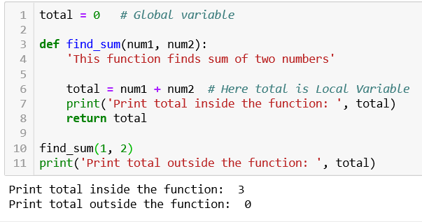
Example of Global and Local Variables
Printing total inside and outside the function
A variable named total has been defined and initialized to 0 in line 1. This is global variable which can be accessed anywhere in the program.
Another variable with the same name total has been assigned value of sum of num1 and num2 in line 6. As this is assigned inside the function, this can not be accessed outside the function.
We can see from the output that if we print total inside the function then it is printing sum of two numbers but at outside total variable is still 0.

Slide 22
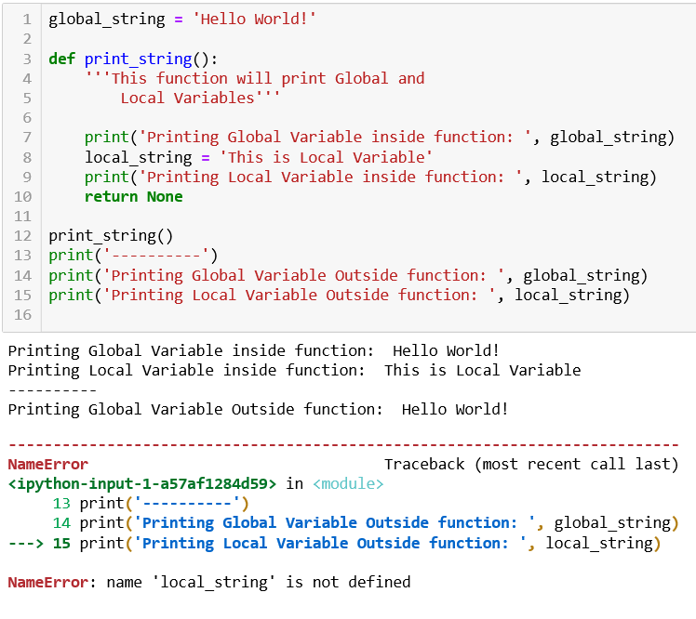
Example 2- Global and Local Variable
A global variable is initialized in line 1.
This global string is accessible inside the function as seen that line 7 get printed.
A local variable is defined inside the function named local_string.
This variable get printed inside the function in line 9.
In line 14, the global variable has been printed.
But when we tried to print the local variable, defined inside the function, in line 15 which is outside the function, then the interpreter produces an error message saying name ‘local_string’ is not defined.
Hence, we can see that the scope of local variable is just inside the function.
And the scope of Global variable is throughout the function.

Slide 23
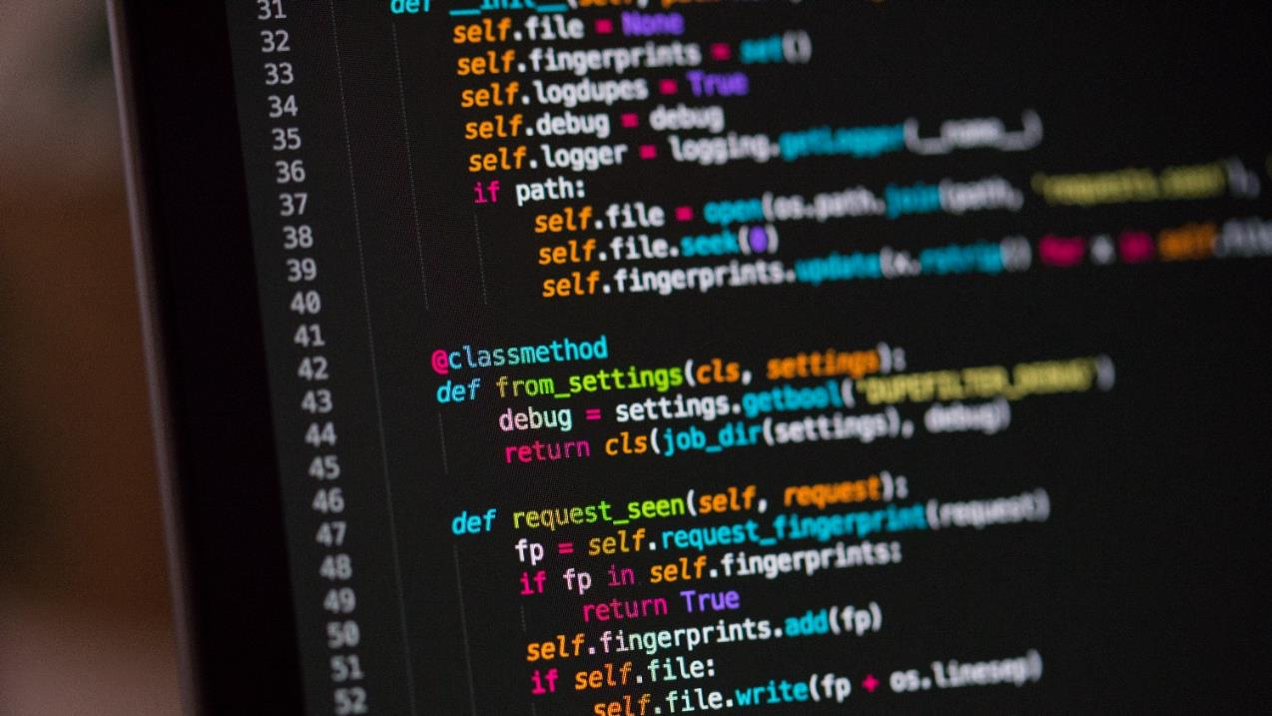
Why Python?

Slide 24
Switching Gears: Why Python?
Now that you’ve spent 6 classes (9 hours!) learning Python – why do we learn it?
Python is high level, interpreted and general-purpose programming language that focuses on code readability.
The syntax of Python helps programmers to do coding in few steps in comparison to other programming languages like Java/C++.
Python is widely used in large and small organizations because of its versatility, conciseness and support for multiple programming paradigms.
It has many characteristic features like being interactive, interpreted, Modular, Dynamic, object-oriented, Portable, High level, extensible in C & C++.

Slide 25
Advantages of Python
Python has extensive application in software development companies such as Gaming, web frameworks, language development, graphic design applications, etc.
Python provides extensive support for Libraries like string operations, internet, web service tools, operating system interfaces, etc. which limit the length of the code.
With its strong process integration features, unit testing frameworks and enhanced control capabilities contribute towards increased speed and productivity while building applications.

Slide 26
Python in Data Science and AI
Python provides powerful frameworks for Machine Learning Algorithms, data analysis and Exploration along with flexibility in Coding which makes the programmer comfortable at coding.
There are many Machine Learning frameworks like scikit-learn, tensorflow, pytorch, keras, nlp, etc which can provide almost every algorithm. We just need to call then in our code.
There are many Data analysis and visualization frameworks like numpy, pandas, matplotlib, seaborn, plotly, etc. which helps to make interactive graphs.
IMHO: easy to learn and write!

Slide 27
Python
Web Development
Data Science
Data Analytics
Artificial Intelligence
Frameworks:
- Django
Flask
TurboGears
Web2py
Pyramid
Bottle
Flask
CherryPy
Frameworks:
Numpy
Pattern
Scikit-learn
Keras
Shogun
Cython
Scipy
Dask
Tensorflow
pytorch

Slide 28
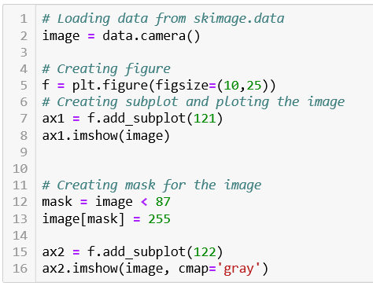
Advanced Programming: mask an image
1) Program to mask an image
We needs to import some libraries in order for this code to run like matplotlib, skimage.
Line 2 loads the image of camera from skimage.data.
Line 5 creates figure.
Line 7 creates a subplot in the figure and line 8 shows that image.
Line 12 creates mask that is if value of pixels in image is less than 87 then it will be 1 else 0.
0 is black color while 255 is white color.
In line 13, we will make all the 1 values to 255.
Line 15 and 16 plots this image in the second subplot.

Slide 29
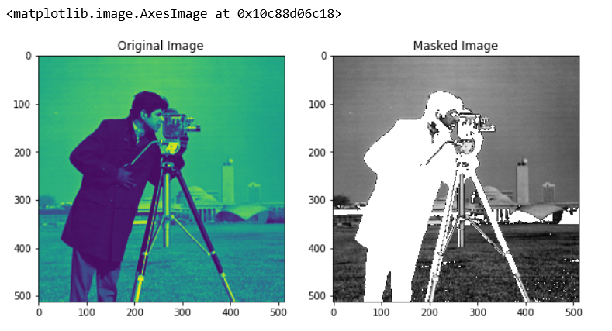
Output
We can see that the original image has been converted into black and white image.

Slide 30
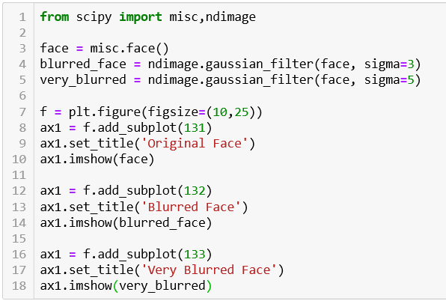
2) Program to Blur an image
We need to import some packages from scipy module like misc and ndimage.
In line 3, we have loaded image of face fro misc.
In line 4 and 5, we have added noise to the image using gaussian filter with different sigma values.
Then all the three images has been plotted using subplot.

Slide 31
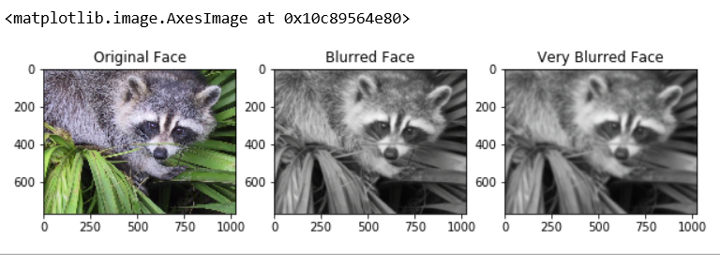
Output
First one is the original image, second one is blurred and third one is very blurred image.

Slide 32
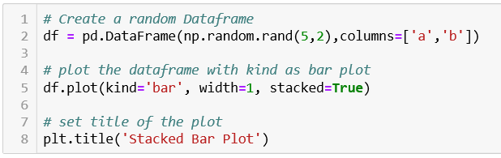
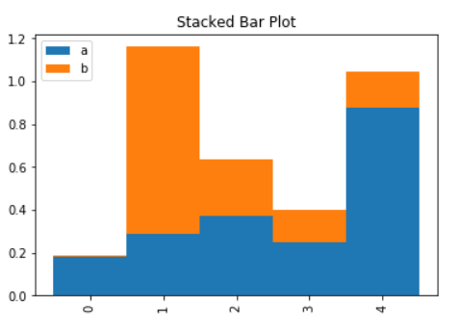
3) Program to create Stacked Bar Plot
Output
We need to import pandas library to run this code.
In line 2, we have created a random data frame with two columns named ‘a’ and ‘b’.
Line 5 plots the data frame as stacked bar plot.
Stacked means the two columns will be one above the other.
Line 8 sets the title for the Plot.

Slide 33

Thank you!
Hope you enjoyed your 6 classes of Python!
It’s a vast ocean out there – for most of you, this might be the first step of your journey.
Continue learning and improving your skills!
Please e-mail me if you have any questions at all.

